Slide 1
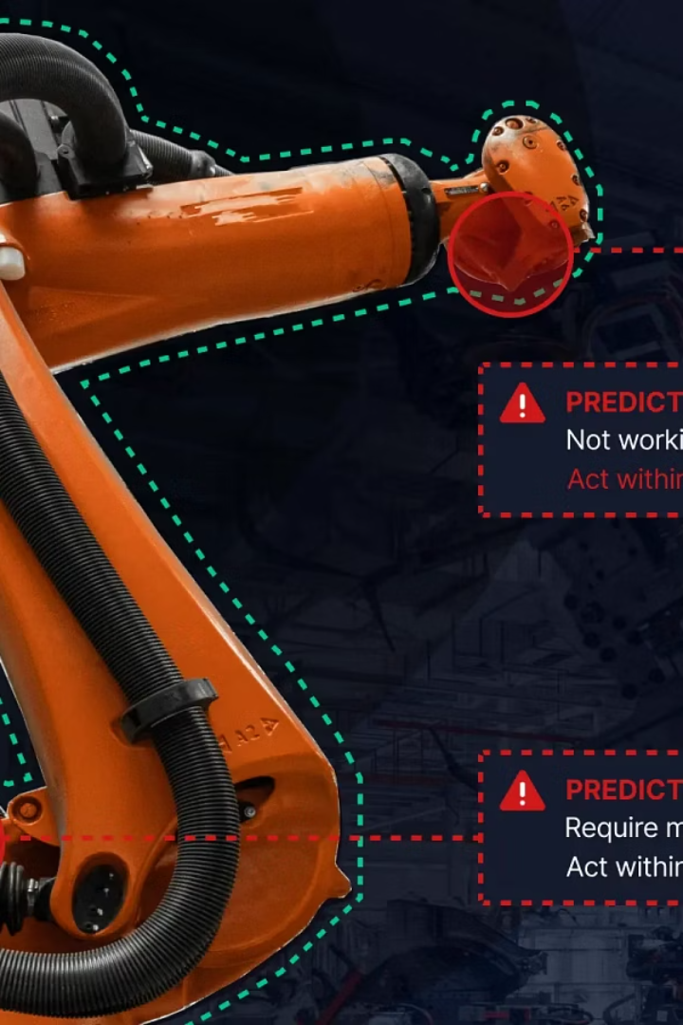
SparkCognition: Revolutionizing Predictive Maintenance
AI-powered solutions are transforming traditional maintenance strategies across aerospace and manufacturing industries. SparkCognition stands at the forefront of this revolution, delivering cutting-edge predictive analytics that reduce costly downtime, enhance operational safety, and optimize complex industrial processes.
Through advanced machine learning algorithms and artificial intelligence, SparkCognition enables organizations to transition from reactive maintenance approaches to proactive strategies that anticipate failures before they occur, saving millions in prevented disruptions while extending asset lifecycles.
By :-
Pranav Sharma(102316087) Tanmay Singh(102316072) Rishav Kumar(102316097)

Slide 2
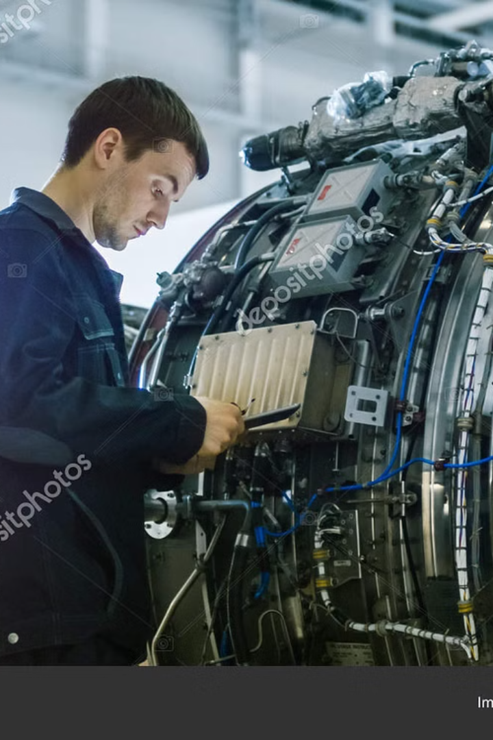
The Maintenance Challenge
$411B
40%
Annual Loss
Preventable
Economic impact from equipment failures across industries
Percentage of failures that could be predicted with AI
70%
Cost Savings
Potential reduction in maintenance expenses with predictive approaches
Traditional maintenance strategies rely heavily on reactive repairs after failures occur or rigid schedule-based approaches that often replace components prematurely. These inefficient methods create massive financial burdens, particularly in aerospace and manufacturing where equipment downtime can cost thousands per minute.
The industry also faces a growing skills gap as experienced technicians retire, taking valuable diagnostic expertise with them. Modern operations require more intelligent, data-driven maintenance approaches that can preserve this knowledge while improving outcomes.

Slide 3








SparkCognition's AI Approach
Actionable Predictions
Converting data into maintenance decisions
Pattern Detection
Analyzing thousands of data points
Model Building
Automated supervised/unsupervised learning
Data Collection
Integrating operational and historical inputs
SparkCognition's advanced machine learning models identify abnormal system behavior well before traditional monitoring methods detect problems. By analyzing thousands of sensor data points simultaneously, these algorithms detect subtle patterns that human operators might miss.
What sets this approach apart is its adaptability to specific equipment profiles and operational contexts. The system transforms even sparse historical failure data into valuable predictive insights through sophisticated AI techniques that continuously improve over time.

Slide 4








SparkPredict: Core Technology
System Alerts
Subcomponent Identification
Monitoring for abnormal behavior patterns
Isolating problematic elements
Model Refinement
Detailed Support
Continuous learning from outcomes
Providing evidence for maintenance decisions
SparkPredict forms the cornerstone of SparkCognition's predictive maintenance solution. This sophisticated analytics software employs a three-layered modeling approach that first alerts operators to system-level abnormalities, then identifies the specific subcomponents likely causing issues, and finally provides detailed supporting information for maintenance teams.
What traditionally required years of deployment time has been compressed into months through SparkCognition's innovative processes. The technology integrates seamlessly with existing sensors and systems, eliminating the need for expensive new monitoring equipment while delivering actionable insights faster.

Slide 5





Case Study: Military Aviation
120,000 Records
Maintenance history analyzed
Reliability Curves
Generated for critical parts
70% Accuracy
In predicting failures months ahead
Improved Readiness
Enhanced mission capability
SparkCognition's partnership with SOFWERX demonstrates the technology's real-world impact in military aviation maintenance. During a focused 12-week project, the team analyzed over 120,000 historical maintenance records to generate precise reliability curves for mission-critical aircraft components.
The results were remarkable: the system achieved 70% accuracy in predicting component failures months before they occurred, even with limited historical data. This dramatically improved aircraft mission readiness while reducing the variability in maintenance operations that often plagues military aviation fleets.

Slide 6


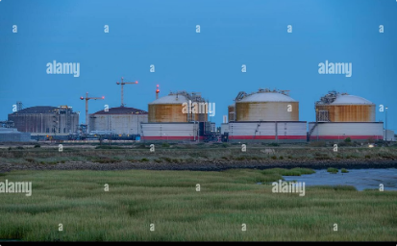
Application in Manufacturing
Oil & Gas Advisor
SparkCognition's specialized solution for asset optimization in petrochemical facilities provides real-time insights that significantly improve overall equipment effectiveness while reducing maintenance costs.
BP Integration
Implementation across BP facilities enables continuous monitoring of critical subsystems, detecting potential failures weeks in advance and allowing for scheduled maintenance during planned downtime periods.
National Grid Success
At the Grain LNG Terminal, SparkCognition's technology seamlessly integrated with existing systems, providing maintenance teams with actionable intelligence without disrupting established workflows.
The manufacturing sector has embraced SparkCognition's predictive maintenance solutions across diverse applications. From oil and gas facilities to power generation plants, the technology adapts to each environment's unique requirements while delivering consistent value through enhanced asset reliability.

Slide 7




Implementation Strategy
Data Ingestion
Collection from multiple sources
Model Building
AI-powered analysis as a service
Real-time Pipeline
Continuous monitoring execution
Alert System
Actionable maintenance notifications
Successfully implementing SparkCognition's predictive maintenance solution follows a structured approach beginning with comprehensive data ingestion from multiple sources. The platform's model building-as-a-service approach eliminates the need for in-house data science expertise, allowing maintenance teams to focus on operations rather than algorithm development.
Real-time data pipelines continuously feed the system with current operational data, while sophisticated alerting mechanisms notify teams of potential issues with appropriate priority levels. The system supports deployment across various environments including on-premises, private cloud, or public cloud installations to match each organization's security and accessibility requirements.

Slide 8
Benefits and Future Directions
Operational Benefits
Strategic Advantages
Future Developments
70% failure prediction accuracy
Transition from reactive to truly predictive operations
Deeper integration with autonomous systems
30-50% reduction in maintenance costs
Preservation of institutional knowledge
Expanded cross-industry applications
Up to 25% improvement in operational uptime
Data-driven decision making
Enhanced supply chain integration
Significant enhancement of safety metrics
Extended asset lifecycles and improved ROI
Advanced digital twin capabilities
SparkCognition's predictive maintenance solutions deliver substantial benefits across operational and strategic dimensions. Organizations implementing these technologies routinely report significant cost savings through reduced emergency repairs and optimized maintenance scheduling, alongside enhanced safety through early problem detection.
Looking forward, SparkCognition continues to advance its capabilities, developing deeper AI integration with autonomous systems and expanding applications across new industries. As the technology evolves, the vision of truly predictive maintenance—anticipating and addressing issues before they impact operations—becomes increasingly attainable for forward-thinking organizations.

Slide 9
Thank you

